Slide 1
Supplier Performance Risk System (SPRS)
Kevin Devers – Procurement Analyst
Vendor Performance Division
DLA Land & Maritime – BPCA
October 2024

Slide 2

PPI Timeline – The 1990’s
1994
Federal Acquisition Streamlining Act
It is appropriate for a contracting official to considerpast contract performance of an offeror as an indicator of the likelihood that the offeror will successfully perform a contract to be awarded by that official

Slide 3
Best Value Award Determination
“Best value buying procedures” encourage award decisions on the basis of a business judgment and recognize that an award to other than the low offeror may represent overall best value to the Government
*No longer operating solely on the basis of “lowest bid most technically acceptable offer”

Slide 4
PPIRS-SR NG Sunset
DLA’s past performance program has been the Past Performance Information Retrieval System (PPIRS)
We have transitioned to the Supplier Performance Risk System (SPRS) effective 28 January 2018
SPRS (pronounced “Spurs”) is used by all of the Department of Defense (DoD)

Slide 5
What is SPRS?
SPRS is a web-enabled, Federal enterprise-wide application that provides timely and pertinent contractor past performance information to the Department of Defense and Federal acquisition community for use in making competitive source selection decisions

Slide 6
What is SPRS?
SPRS is the sole Federal repository for contractor past performance information
System is owned & maintained by the Navy (Naval Sea Logistics Center Portsmouth)
SPRS captures procurement history on awards below the established threshold of $5 million for DLA
Includes data feeds from all of the ArmedServices

Slide 7
General Advantages
Government Incentives:
Identify/Eliminate procurement risks
Decrease contract administration costs
Exercise best value determinations
Vendor Incentives:
Maintain surveillance of their supplier scores
Understand what records may be impacting (+/-)
Formally challenge any erroneous data

Slide 8
How Does SPRS Work?
SPRS collects quality and delivery data from numerous Department of Defense (DoD) databases, aggregates that data using algorithms, and providesthe user with objective Quality and Delivery Ratings of a contractor’s past performance
“Weighted Delivery Score”
Quality Color Classification

Slide 9
SPRS Business Rules
Uses 3 years of past performance/historical data
Scores/Classifications are now updated each day vs. each month (24-48hr lag for system interface)
Performance data is classified by cage & commodity
  Federal Supply Classification - FSC (DoD uses)
  NAICS - North American Industry Classification System
Quality and Delivery records are weighted (+ &-)
  Scores are classified in Positive/Negative record categories

Slide 10
Delivery Performance
Scores/Classifications are based on the total number of Contract Line Items (CLIN’s) shipped or received
Weighted delivery scores are presented as a numeric value (Range: 0 - 100)
An unscored offeror, or one that has no past performance history for the particular FSC, is considered to be neutral (not negative or positive)

Slide 11
Delinquency Factors
Delinquent lines include
  Lines not shipped by the contract deliverydate (CDD)
  Lines partially shipped by the (CDD)
Contractor-caused cancellations and terminationsare coded Termination Indicator Code (TIC) K
Terminations for Default (TIC) D
Government-caused cancellations/terminations will not impact the delivery score (TIC) G
No grace period past the established (CDD)

Slide 12
Delinquency Factors
Days Late Exceptions: Cancellations/Terminations are counted as delinquencies in some instances.
Contractor Requested cancellations (TIC) K will be assessed at 180 days late
Terminations for Cause/Convenience (TIC) K will be assessed at 180 days late
Terminations for Default (TIC) D will be assessed at 360 days late
Awards cancelled/terminated Cause/Convenience (TIC) G are not included in the delivery score

Slide 13
Vendor Classifications
Delivery Extension Modifications:
  Contractor-caused delivery extensions, regardless of consideration paid, will be reflected in the delivery score for contracts issued by DLA
  Government-caused or excusable delay delivery extension modifications will not impact performance scores
  Exceptions FAR 52.249-14
    Additional evidence may be required to validate

Slide 14
Vendor Classifications
Scoring Types Classifications:
  Current (Being used by Contracting Officials)
Pending (No longer being used)
Evaluation Criteria:
https://www.sprs.csd.disa.mil/reference.htm
Vendor Challenge Process:
Suppliers MUST access SPRS to review and formally challenge scoring data
May challenge each case a total of 2x times
May challenge any case within the 3 year capture period
New records challenged during the 14 day preview period will still be held out of scoring consideration until adjudicated

Slide 15
Registration In SPRS
Your name should appear on the System for Award Management (SAM) as a past performance point of contact for your company in order to have SPRS recognize your email address automatically when processing a challenge requests
You can access SAM at www.sam.gov

Slide 16
Digital Certificate Requirement
SPRS Users:
Public Key Infrastructure (PKI) Certificate now required
  Purchase from External Certificate Authority(ECA)
  Mandatory as of 15 Aug. 2015 for all users
  DLA is not involved in the approval of vendor account registration or PKI certifications.
  Contact SPRS Helpdesk for registration or PKI certification related inquiries
    Webmaster: webptsmh@navy.mil
    Phone: (207) 438-1690
More information available at: https://www.sprs.csd.disa.mil/split.htm https://www.sprs.csd.disa.mil/pki_info.htm

Slide 17
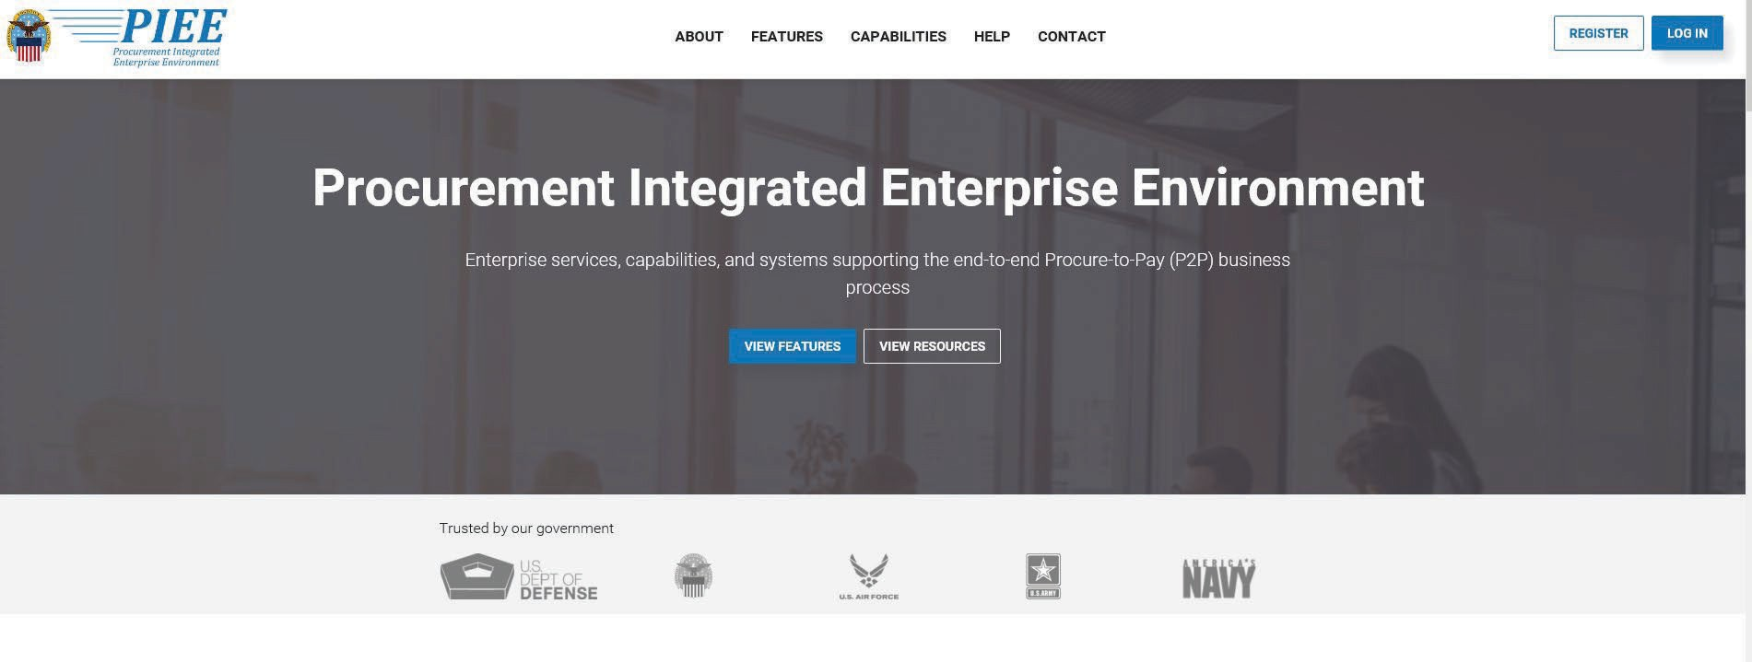
Access SPRS via P.I.E.E.

Slide 18
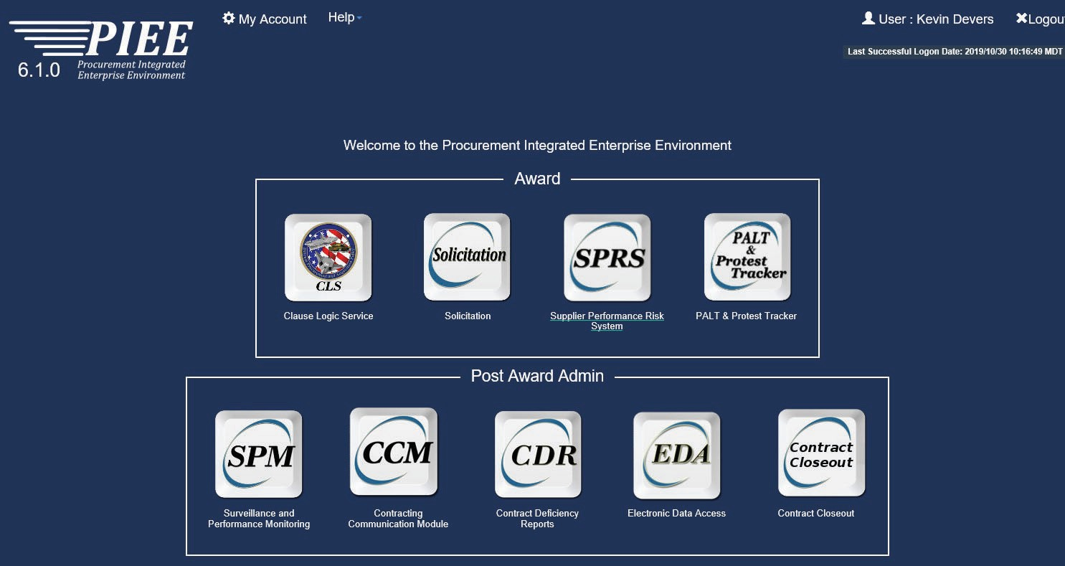
Request Account Access Role

Slide 19
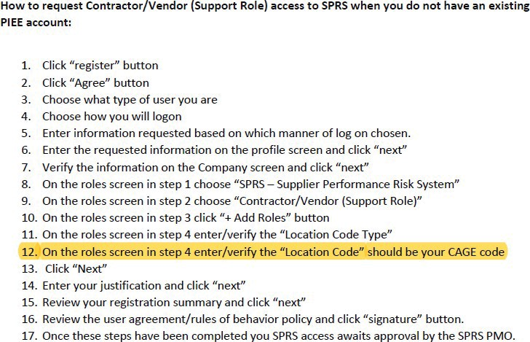
Registration Without Active P.I.E.E.

Slide 20
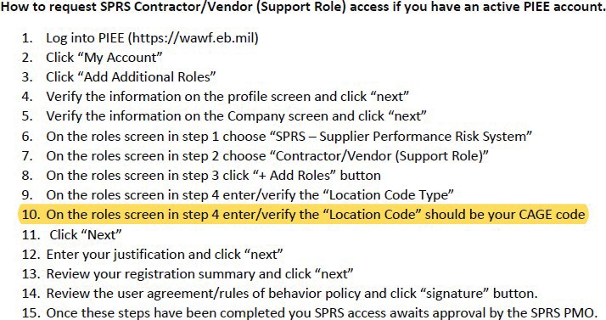
Registration With Active P.I.E.E.

Slide 21
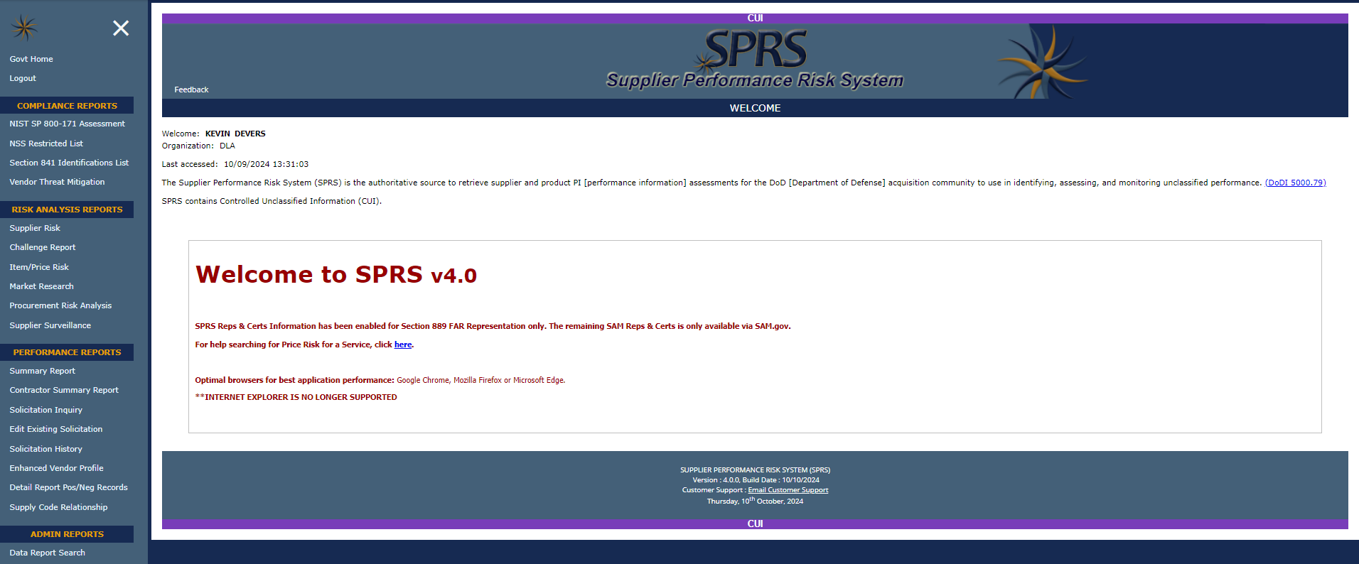
SPRS Government View

Slide 22
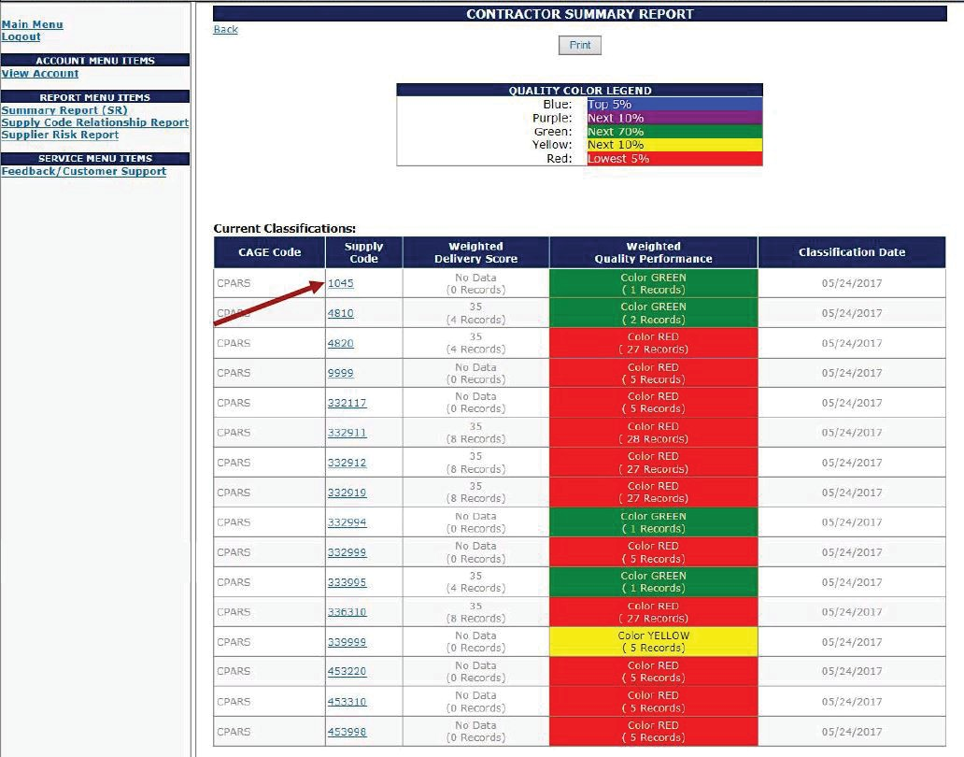
SPRS Summary Report
Summary Report
Company Description
Current Classification
  CAGE
  FSC’s Supplied
  Weighted Delivery Score
  Weighted Quality Rating
  Data Classification Date
Points of Contact
Select the FSC For Detailed Report

Slide 23
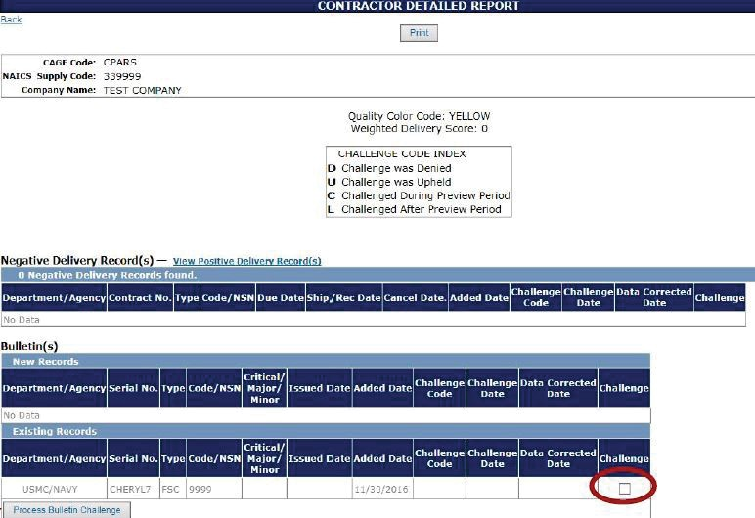
SPRS Detail Report
Displays Positive & Negative Data
  Positive & Negative Delivery Records
  Positive & Negative Quality Records
Displays Various Data Fields
  Procurement Activity
  Contract#/NSN
  Ship/Receipt Date
  Cancellation Date
  Challenge Code/Date
Record Challenge
  Select the Record
  Process CDD Challenge
  Sends Challenge E-mail to Government POC
  Attach all supporting documentation to e-mail

Slide 24
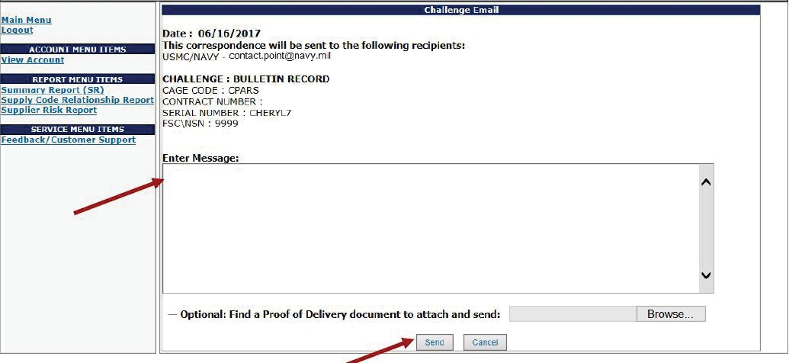
SPRS Challenge Screen
Enter Message Regarding Challenge
Select “Send” to Send E-Mail - MUST attach supporting documentation
Select “Cancel” to Cancel Challenge

Slide 25
Documentation Needed to Support Challenges
Email correspondence between your organization and your contract administrator
Wide Area Workflow (WAWF) or IRAPT shipping documents (receiving reports, invoices, DD-250’s)
Bill of Lading, UPS/Fed-Ex shipping docs, etc.

Slide 26
Registration In SPRS
Your name should appear on the System for Award Management (SAM) as a past performance point of contact for your company in order to have SPRS recognize your email address automatically when processing a challenge requests
You can access SAM at www.sam.gov

Slide 27
SPRS Team Points of Contact
Administrators
DLA Land and Maritime LMPPIRS@dla.mil
Kevin T. Devers Kevin.Devers@dla.mil
Administrators DLA Aviation DSCRPPIRS@dla.mil
Telephone #
Monitored Mailbox (614) 692-8480
Email Preferred Monitored Mailbox

Slide 28
SPRS Team Points of Contact
Administrators
Telephone #
DLA Troop Support DSCPABVS@dla.mil
Tim Atwell
Timothy.Atwell@dla.mil
Monitored Mailbox
(215) 737-7844
These emails are to be used for questions ONLY and NOT to be used for challenging the SPRS performance data
Challenges MUST be initiated through the SPRS website

